Slide 1
Data Exploration For Actionable Business Insights
Project
Monu Kaushik
DSBA
IIT Kanpur

Slide 2
Problem Statement
'CARS24’ Dataset
Define Car Excellence
Spot Trends and Preferences
Guide Informed Decision-Making
Enhance Market Edge

Slide 3

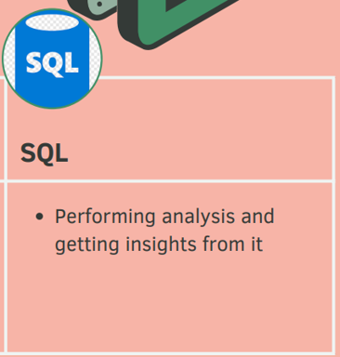
Tools Used In This Project

Slide 4
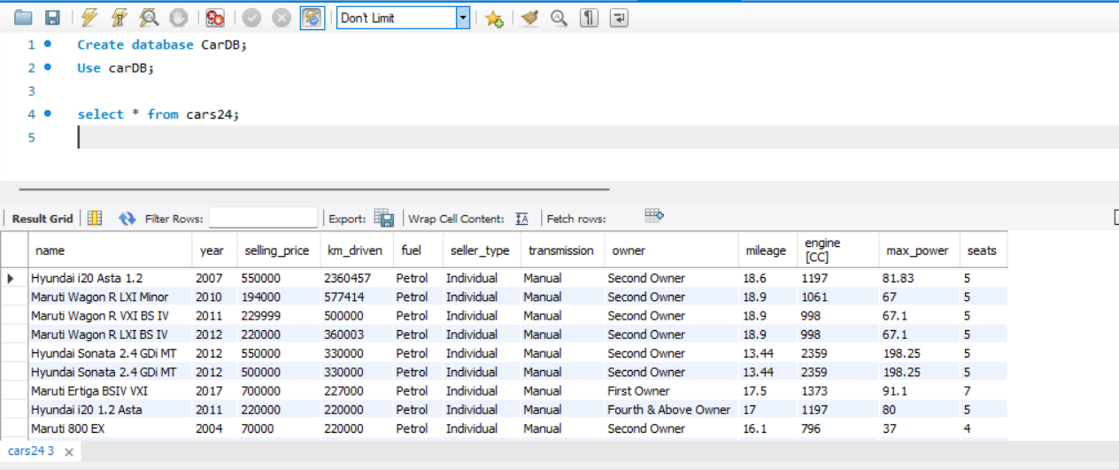
Business Insights

Slide 5
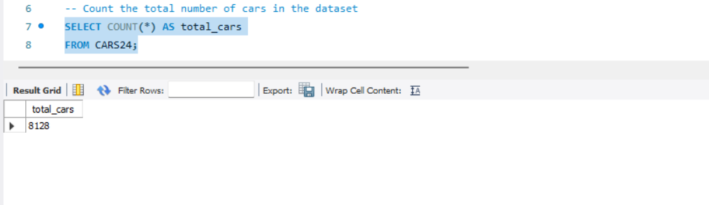
Insights - 2

Slide 6
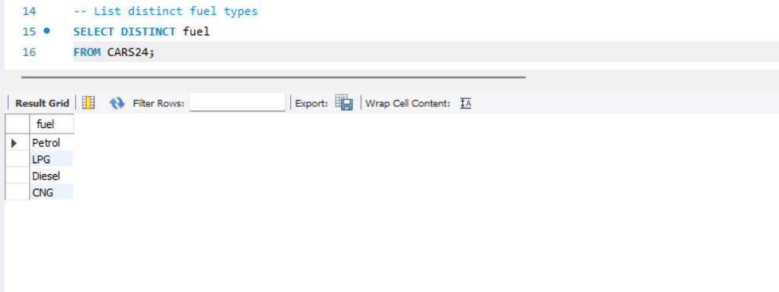
Insights - 3

Slide 7
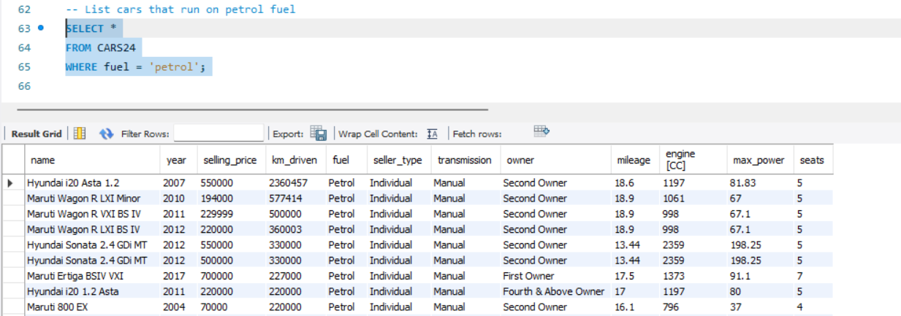
Insights - 4

Slide 8
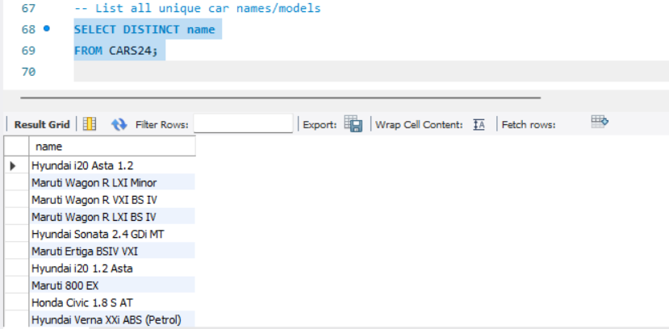
Insights - 5

Slide 9
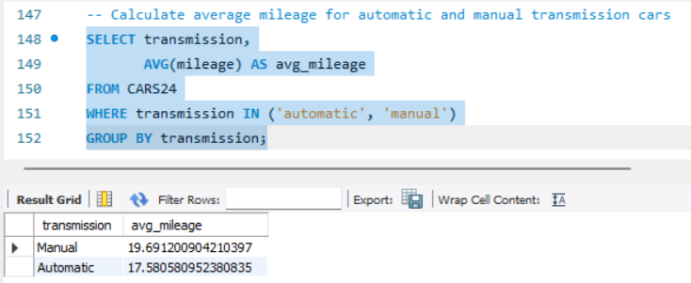
Insights - 6

Slide 10
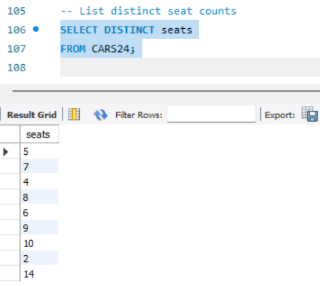
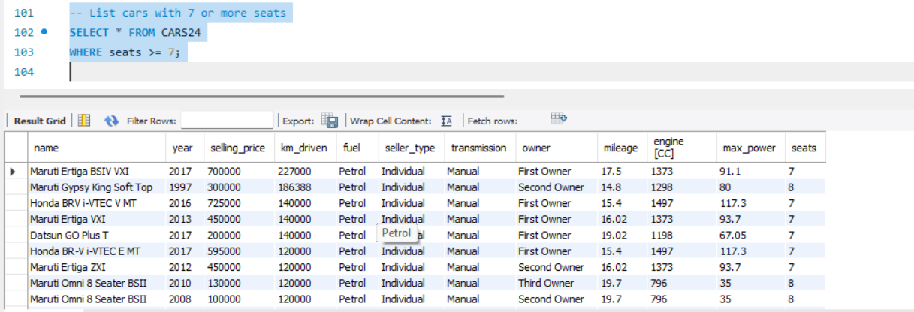
Insights - 7

Slide 11
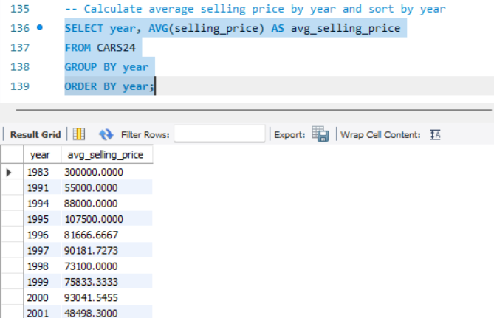
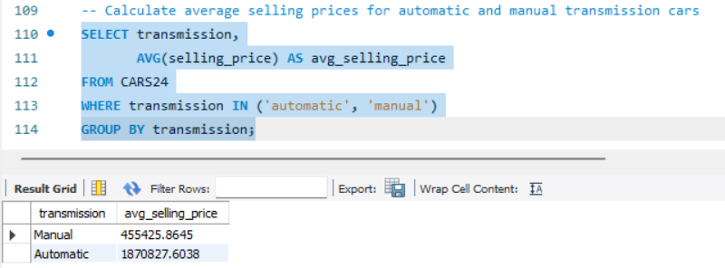
Insights - 8

Slide 12
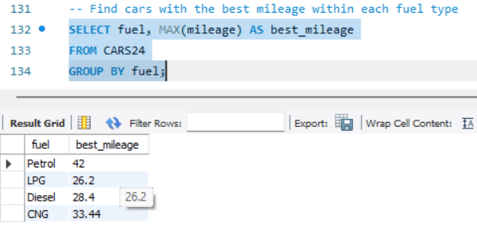
Insights - 9

Slide 13
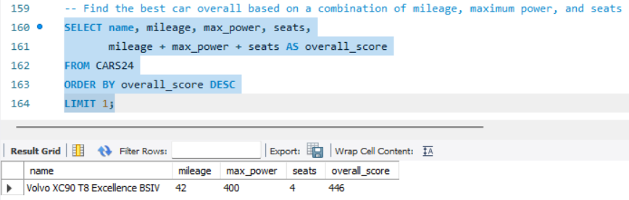
Insights - 10

Slide 14
Key Insights
There are a total of 8,128 cars available in the dataset.
There are a total of 2448 cars from Maruti, 1415 cars from Hyundai, 772 cars from Mahindra, 734 cars from Tata, 467 cars from Honda, 397 cars From Ford, 228 cars from Renault, 67 cars from Volvo, and 4 From Ambassador.
Most cars have Diesel Fuel type followed by petrol.
The cars From CARS24 mostly have seller_type as individual sellers.
“Volvo XC90 T8 Excellence BSIV” is the best car overall based on a combination of mileage, maximum power, and seats.

Slide 15


